Slide 1
BT201
Biochemical Process Calculations
15/09/2022
Extra class

Slide 2

Problem 1: Dehydrogenation of propane with Recycle
Propane (C₃H₈) is dehydrogenated to form propylene (C₃H₆) in a catalytic reactor.
The process is to be designed for a 95% overall conversion of propane. The reaction products are separated into two streams: the first, which contains H₂ , C₃H₆ , and 0.555% of the propane(C₃H₈) that leaves the reactor, is taken off as product; the second stream, which contains the balance of the unreacted propane and 5% of the propylene in the first stream, is recycled to the reactor.
Calculate the composition of the product,
Calculate the ratio (moles recycled)/(mole fresh feed), and
Calculate the single-pass conversion

Slide 3
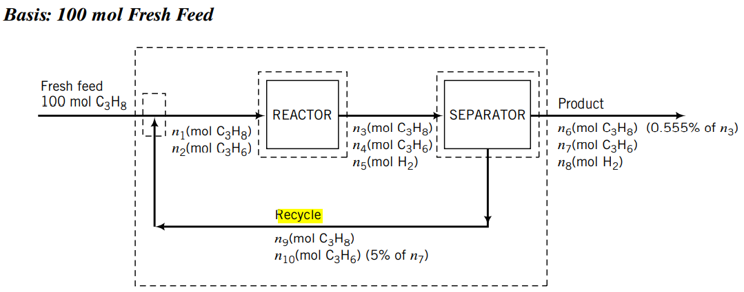
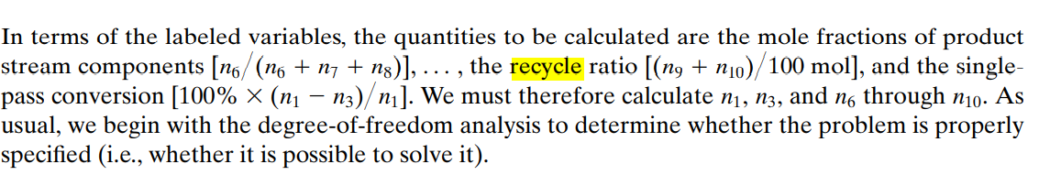

Slide 4
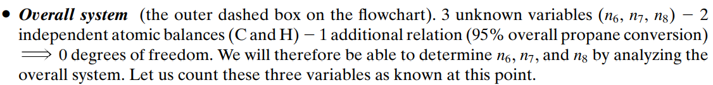
Degree of freedom analysis

Slide 5
We can therefore determine the five given variables associated with the separator and then return to analyze either the mixing point or the reactor; in either case we can write two atomic balances to solve for the two remaining unknowns, thereby completing the solution.

Slide 6

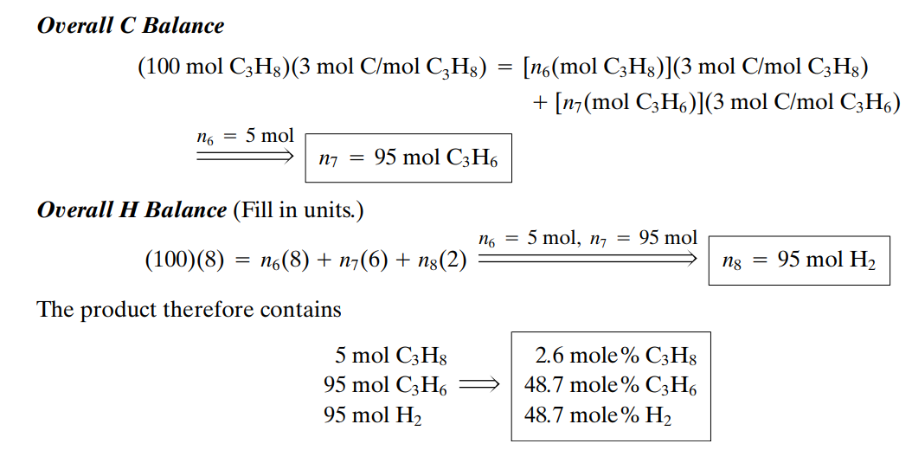

Slide 7
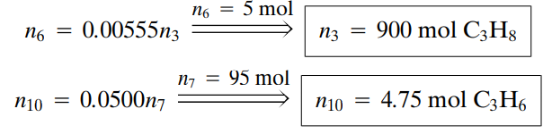

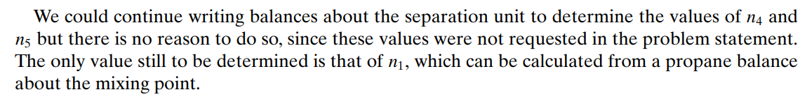

Slide 8
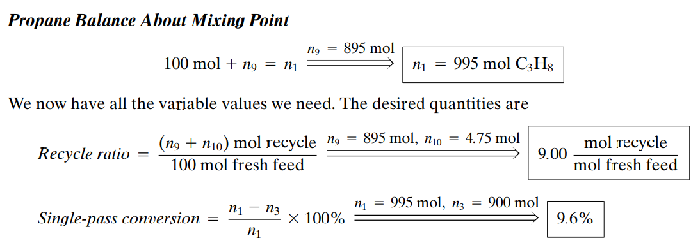

Slide 9
Only about 10% of the propane entering the is converted to propylene in a single pass; however, over 99% of the unconsumed propane in the reactor effluent is recovered in the separation unit and recycled back to the reactor, where it gets another chance to react. The net result is that 95% of the propane entering the is converted and 5% leaves with the final product.
The lower single-pass conversion consequently leads to a decrease in the cost of the reactor. On the other hand, the savings may be offset by the cost of the separation process unit and the pump, pipes, and fittings in the recycle line. The final design would be based on a detailed economic analysis of the alternatives

